Slide 1
Substitution Ciphers

Slide 2
Introduction
Encryption algorithms typically use two operations to convert plaintext into ciphertext.
Substitution operation: In this technique, one element of the plaintext is replaced by another element.
Transposition operation: In this technique, the order of rearrangement of the element is done.

Slide 3

Monoalphabetic Cipher
Rather than just shifting the alphabet
Could shuffle (jumble) the letters arbitrarily
Each plaintext letter maps to a different random cipher text letter
hence key is 26 letters long
  Plain: abcdefghijklmnopqrstuvwxyz
  Cipher Key: DKVQFIBJWPESCXHTMYAUOLRGZN
  Plaintext: ifwewishtoreplaceletters
  Cipher text: WIRFRWAJUHYFTSDVFSFUUFYA

Slide 4
Monoalphabetic Cipher Security
Now have a total of 26! keys
With so many keys, might think the system is secure
But would be !!!WRONG!!!
Problem is the regularities of the language

Slide 5
Language Redundancy and Cryptanalysis
Human languages are redundant
Letters are not equally commonly used
The English letter e is by far the most common letter
Then T,R,N,I,O,A,S
Other letters are fairly rare
Z,J,K,Q,X

Slide 6
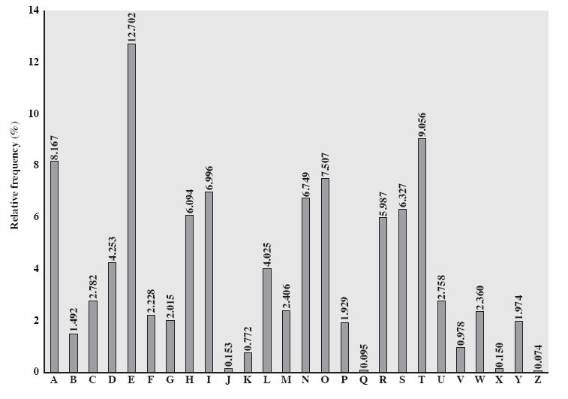
English Letter Frequencies

Slide 7
Use in Cryptanalysis
Key concept - monoalphabetic substitution ciphers do not change relative letter frequencies
Discovered by Arabian scientists in 9th century
Calculate letter frequencies for ciphertext
compare counts against known values

Slide 8
Example Cryptanalysis
Given ciphertext:
  UZQSOVUOHXMOPVGPOZPEVSGZWSZOPFPESXUDBMETSXAIZ
  VUEPHZHMDZSHZOWSFPAPPDTSVPQUZWYMXUZUHSX
  EPYEPOPDZSZUFPOMBZWPFUPZHMDJUDTMOHMQ
Count relative letter frequencies (see text)
The most common letters are P & Z and are equivalent to e and t
The most common Digram are ZW is equivalent to th and hence ZWP is the
Proceeding with trial and error finally get:
  it was disclosed yesterday that several informal but
  direct contacts have been made with political
  representatives of the viet cong in moscow

